Slide 1

PCB Design
Prepared by:
Kunjal Patel (C0754858)
Group 6
Guided by:
Mike Aleshams

Slide 2
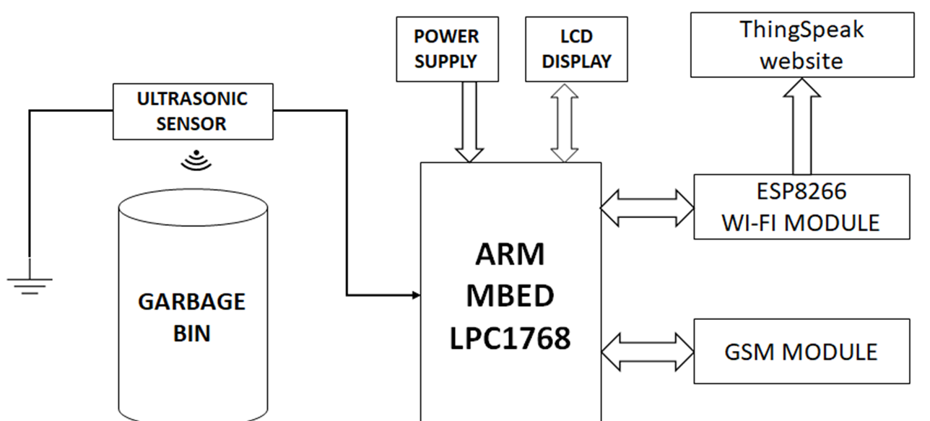
Block Diagram

Slide 3

What is PCB Design?
Printed circuit board is the most common name but may also be called printed wiring boards or printed wiring cards.
A printed circuit board (PCB) mechanically supports and electrically connects electronic components or electrical components using conductive tracks, pads and other features.
The PCB layout and design has a major impact on the way in which a circuit works, and therefore if the printed circuit board is designed in an effective way, then the circuit will perform more reliably and within its specification.

Slide 4
Classification of PCB
1) Rigid PCB:
The rigid PCB has a certain mechanical strength, and the parts installed with it have a certain ability of resistance to bending, and it is usually at a state of flat when used.
the rigid PCBs are always popular with the electronic devices because of its good flatness and excellent performance of resistance to bending.
It is made of solid substrate material, which can effectively prevent the distortion of the circuit board. Perhaps the most common rigid PCB is the computer motherboard.

Slide 5
Flexible PCB
Flexible PCBs are made of soft laminated plastics or other soft insulating materials.
The boards made by the flexible PCBs can easily be bent and stretched, which means that people can bend optionally them when using the flexible PCBs according to the installation requirements.
Flexible PCBS extremely well in extreme temperatures and offer superior resistance to radiation and chemicals.

Slide 6

Single –Side PCB
Single sided PCB is the basic simple PCB, parts is layouted on one side and the circuit is on the other side.
As there is only layer conductor, it is called single sided PCB (Single-sided PCB or one layer PCB).
Single-side PCB is usually made of the laminate or the glass cloth and the conductive pattern of it is relatively simple, so most of them are made by silkscreen printing or wet film process.
Single sided printed circuit boards are commonly used in an array of electronics and applications, including camera systems, printers, radio equipment, calculators, and much more.

Slide 7
Double-side PCB
Double Sided PCBs also known as Double-Sided Plated Thru or DSPT, which is usually made of the epoxy board or the glass cloth.
Double sided PCBs are very similar to single sided PCBs, except that they have two sided traces with a top and bottom layer.
These boards can mount conductive copper and components on both sides of the circuit board, which allows the traces to cross over each other.
The main benefit of double-sided boards is that you have an extra layer to add more components, which effectively increases the density of the circuit.

Slide 8
Multi-layer PCB:
A multilayer PCB is a printed circuit board with three or more layers of conductive graphics.
The conductive graphic of the inner layer of the multi-layer board is superimposed with the insulating bonding sheet, and the outer layers are covered with foils, which are compressed into a whole multi-layer board.
One of the most prominent and lauded benefits of using multilayer PCBs lies in their size. Because of their layered design, multilayer PCBs are inherently smaller than other PCBs with similar functionality.

Slide 9
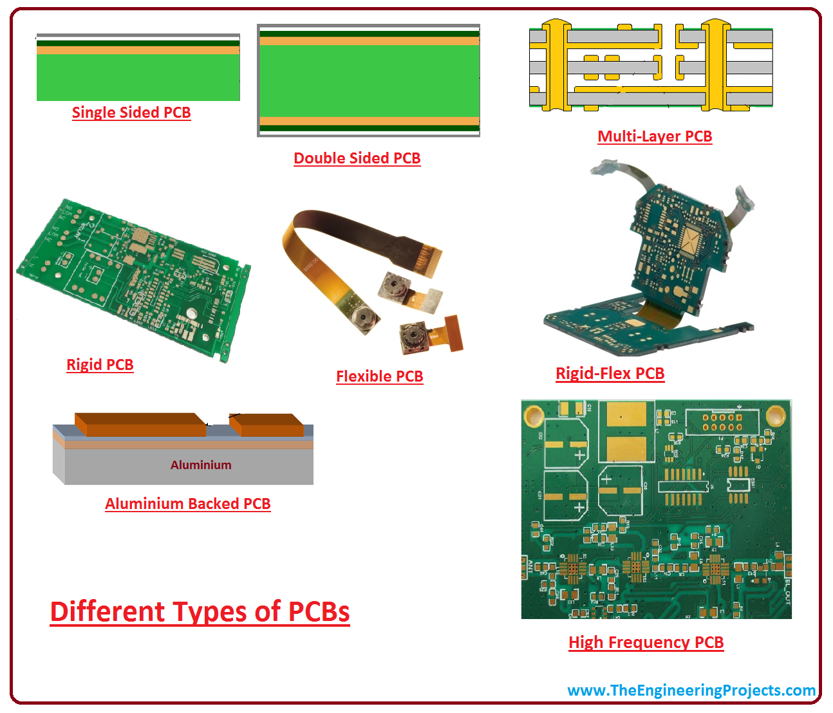
Types of PCBs

Slide 10
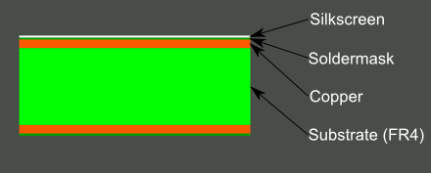
What is a PCB made of?
The four materials which are laminated together with heat and adhesive such that we can see a PCB. The four components are:

Slide 11
1) Substrate
Substrate, also named as dielectric sometimes, is one of the important composition of a PCB.
The base material, or substrate, is usually fiberglass
It is a sheet of insulation like fiberglass material that has two sheets of copper adhered to either side.
This substrate layer provides a solid foundation for PCBs, though the thickness can vary according to the uses of a given board

Slide 12
2) Copper
The next layer is a thin copper foil, which is laminated to the board with heat and adhesive.
On common, double sided PCBs, copper is applied to both sides of the substrate.
In lower cost electronic gadgets, the PCB may have copper on only one side.
When it refers to a double sided or 2-layer board, it referring to the number of copper layers (2) in our lasagna. This can be as few as 1 layer or as many as 16 layers or more.

Slide 13
3) Soldermask
The layer on top of the copper foil is called the solder mask layer.
This layer gives the PCB its green color.
It is overlaid onto the copper layer to insulate the copper traces from accidental contact with other metal, solder, or conductive bits.
This layer helps the user to solder to the correct places and prevent solder jumpers.
Soldermask is most commonly green in color but nearly any color is possible

Slide 14
4) Silkscreen
The white silkscreen layer is applied on top of the Soldermask layer.
The silkscreen adds letters, numbers, and symbols to the PCB that allow for easier assembly and indicators for humans to better understand the board.
We often use silkscreen labels to indicate what the function of each pin or LED.
Silkscreen is most commonly white, but any ink color can be used. Black, gray, red, and even yellow silkscreen colors are widely available.

Slide 15
PCB terminology
Annular ring - the ring of copper around a plated through hole in a PCB.
DRC - design rule check. A software check of your design to make sure the design does not contain errors such as traces that incorrectly touch, traces too skinny, or drill holes that are too small.
Pad - a portion of exposed metal on the surface of a board to which a component is soldered.
Paste stencil - a thin, metal stencil which lies over the board, allowing solder paste to be deposited in specific areas during assembly.

Slide 16
PCB terminology
Drill hit- places on a design where a hole should be drilled, or where they were drilled on the board. Inaccurate drill hits caused by dull bits are a common manufacturing issue.
Pick-and-place - the machine or process by which components are placed on a circuit board.
Footprint- A footprint is the arrangement of pads or through-holes used to physically attach and electrically connect a component to a printed circuit board.

Slide 17
PCB Designing in EasyEDA
EasyEDA is a web-based EDA tool suite that enables hardware engineers to design, simulate, share - publicly and privately and discuss schematics, simulations and printed circuit boards.
Other features include the creation of a Bill of Materials, Gerber and pick and place files and documentary outputs in PDF, PNG and SVG formats.
The PCB design process starts with part research and selection, followed by schematic capture and simulation then board layout and final step is verification and validation.

Slide 18
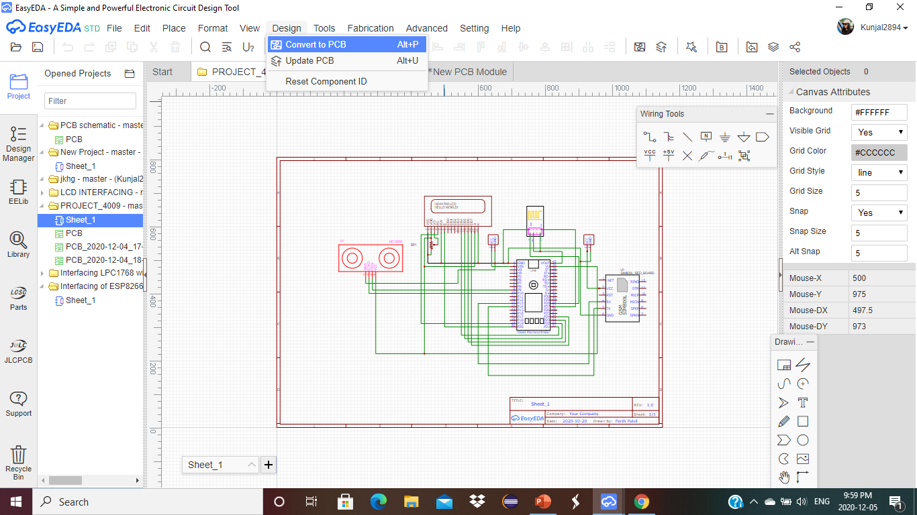
PCB designing in EasyEDA
First is to make schematic in software, then simulation and finally PCB design.

Slide 19
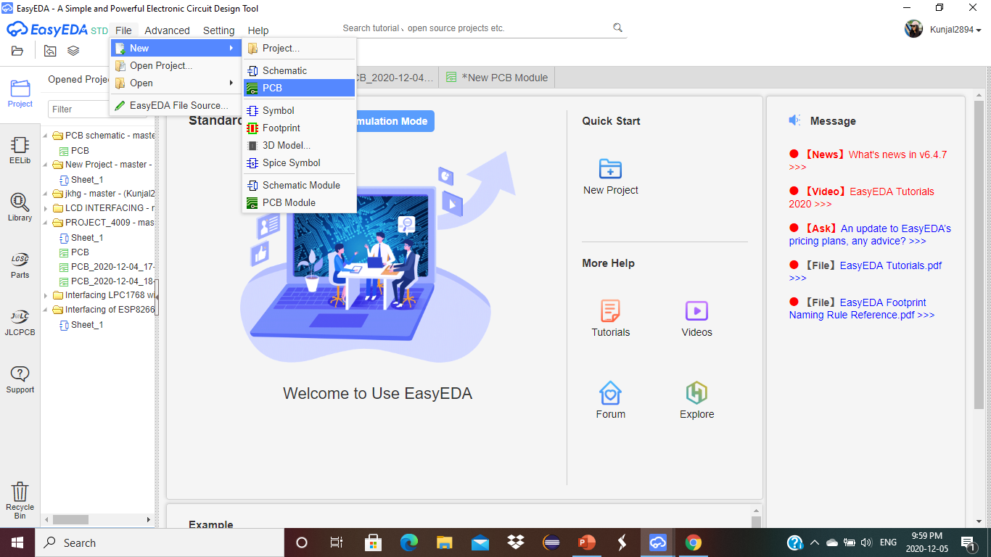
PCB Designing in EasyEDA
The another way is to open a new pcb from file menu.

Slide 20
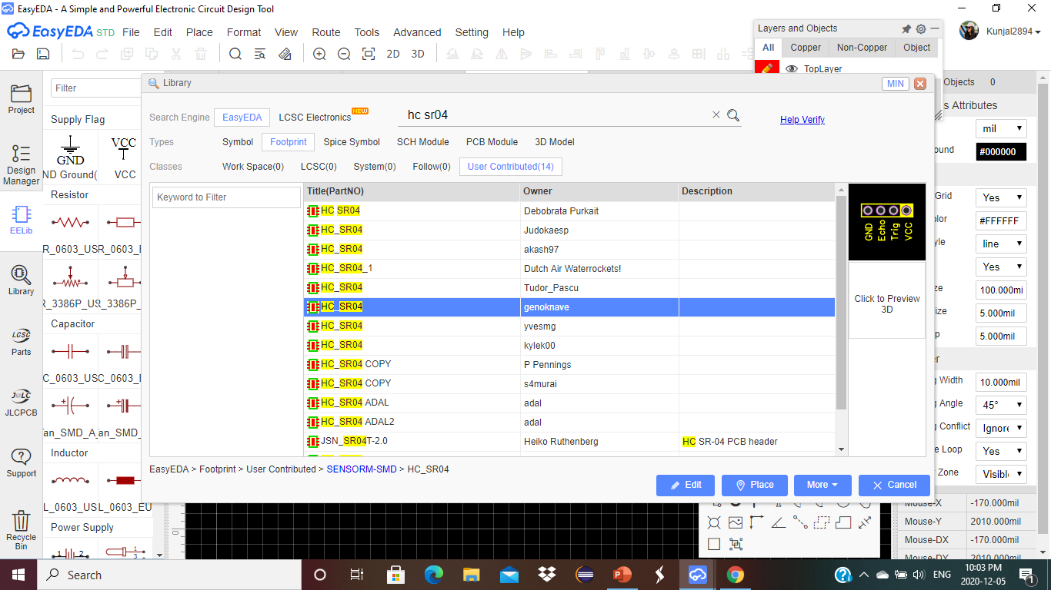
Steps to PCB Design

Slide 21
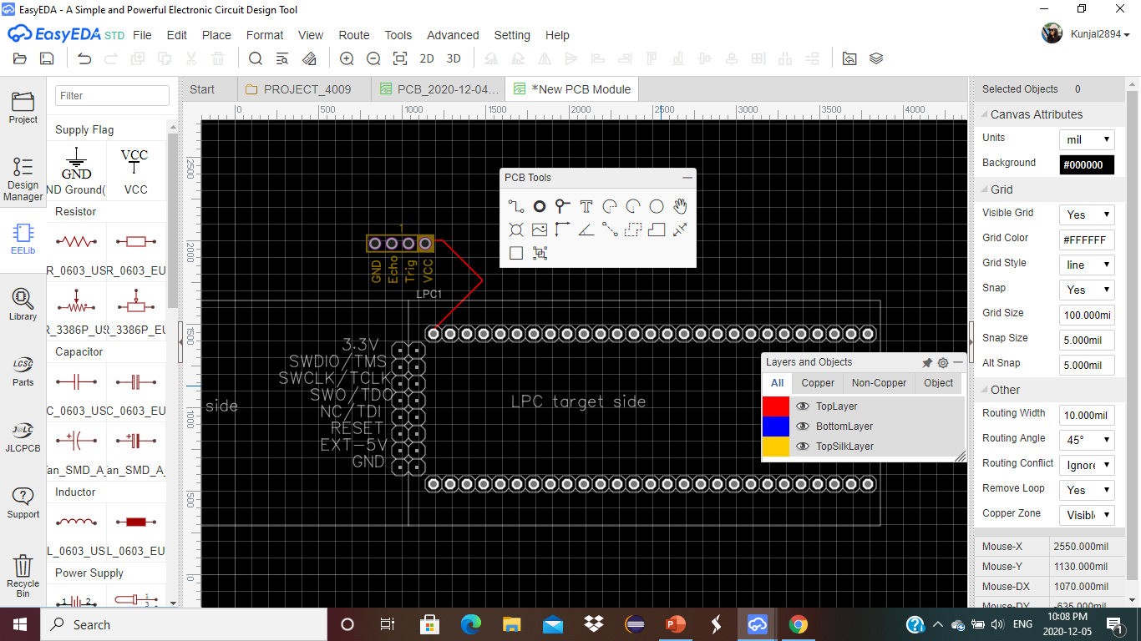
Steps for PCB Design

Slide 22
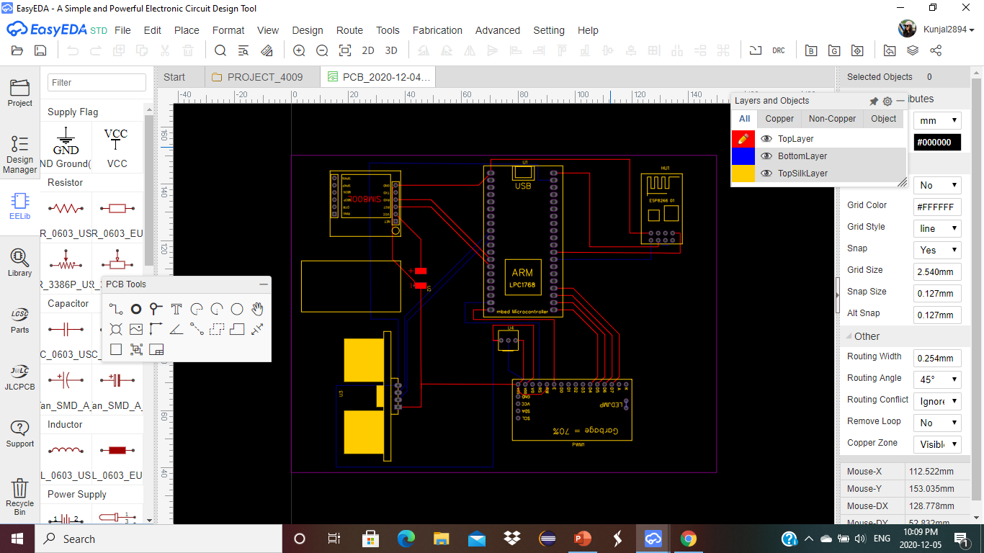
Steps for PCB Design

Slide 23
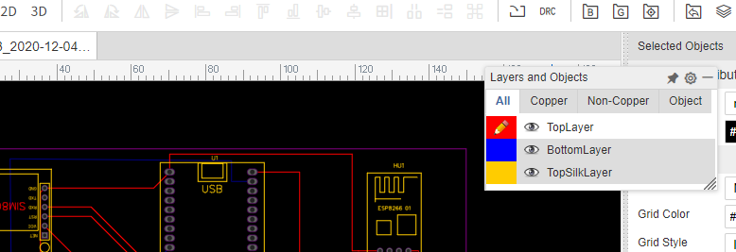
Steps for PCB Design
Here, we have options to see our PCB in 2D and 3D view.
Apart from that, we can check for Design rule, generate the BOM and gerber file.

Slide 24
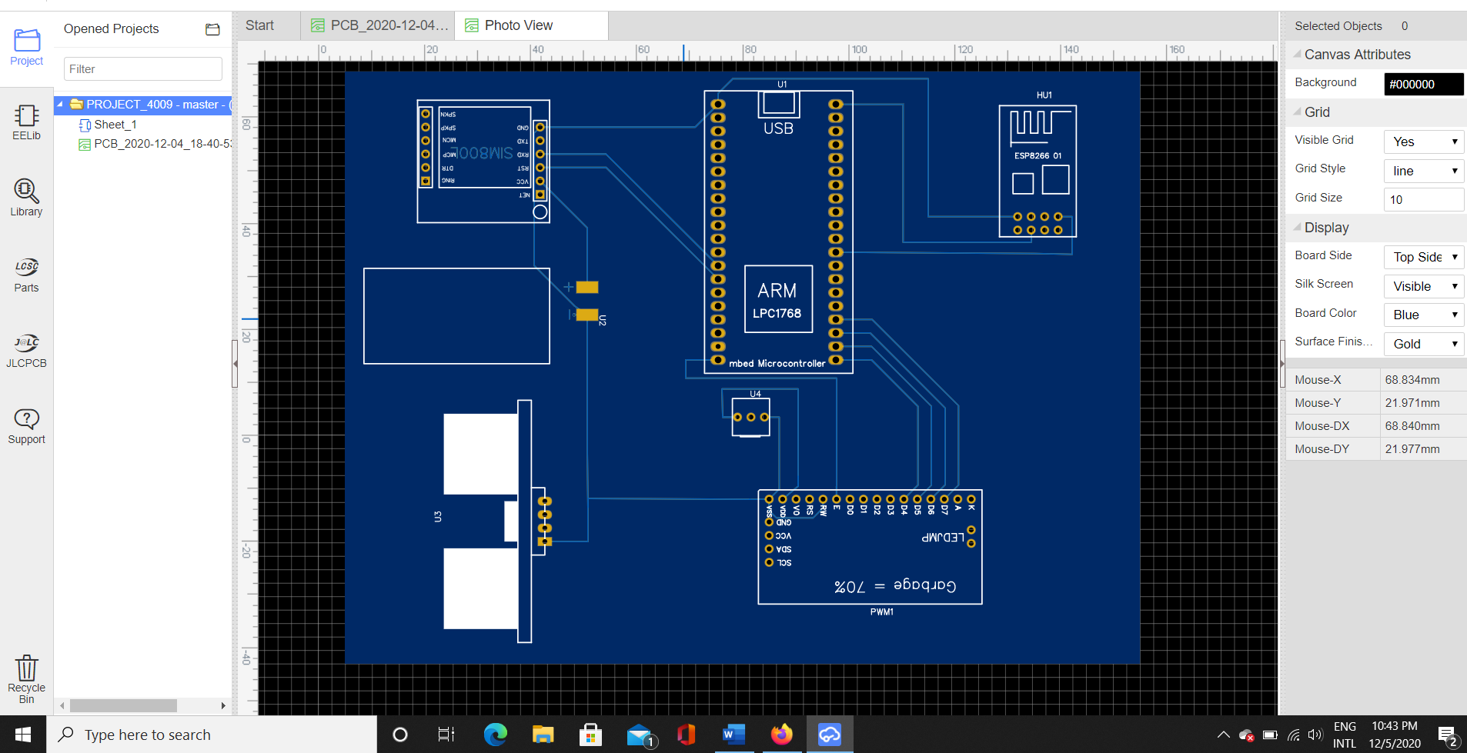
Steps for PCB Design

Slide 25
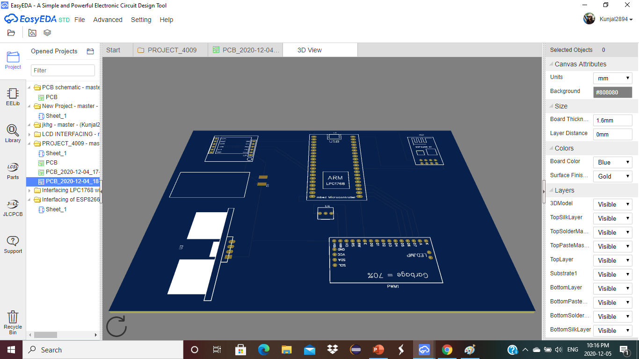
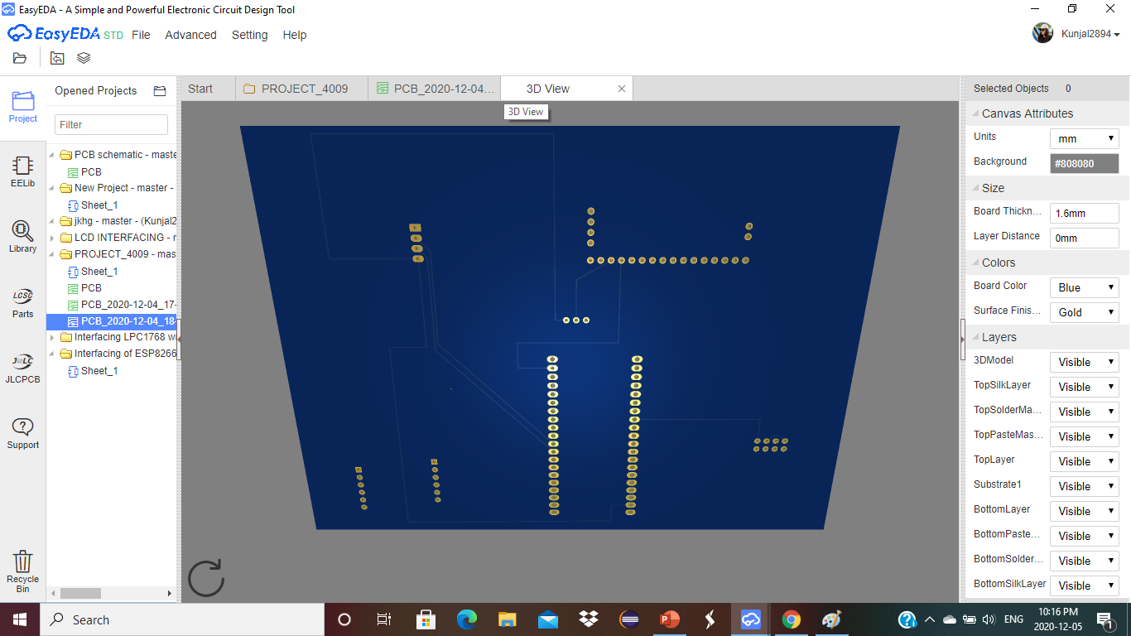
Steps for PCB Design

Slide 26
What is a Gerber File?
Gerber files are open ASCII vector format files that contain information on each physical board layer of PCB design.
Circuit board objects, like copper traces, vias, pads, solder mask and silkscreen images, are all represented by a flash or draw code, and defined by a series of vector coordinates.
These files are used by PCB manufacturers to translate the details of design into the physical properties of the PCB.
Most of today’s Gerber files are generated according to the RS-274X Gerber format.

Slide 27
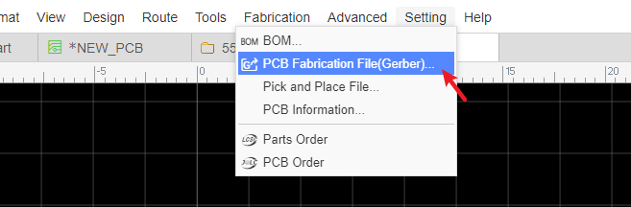
How To Generate Gerber Files in a PCB Design
After the design is complete and done the final check, the next step will be to generate the Gerber files for PCB manufacturer.
The process of doing so varies according to the PCB design software that you’re using.
But in EasyEDA, to generate the Gerber File, we can output the Fabrication Files (gerber file) via: File > Generate PCB Fabrication File(Gerber) , or Fabrication > PCB Fabrication File(Gerber).

Slide 28
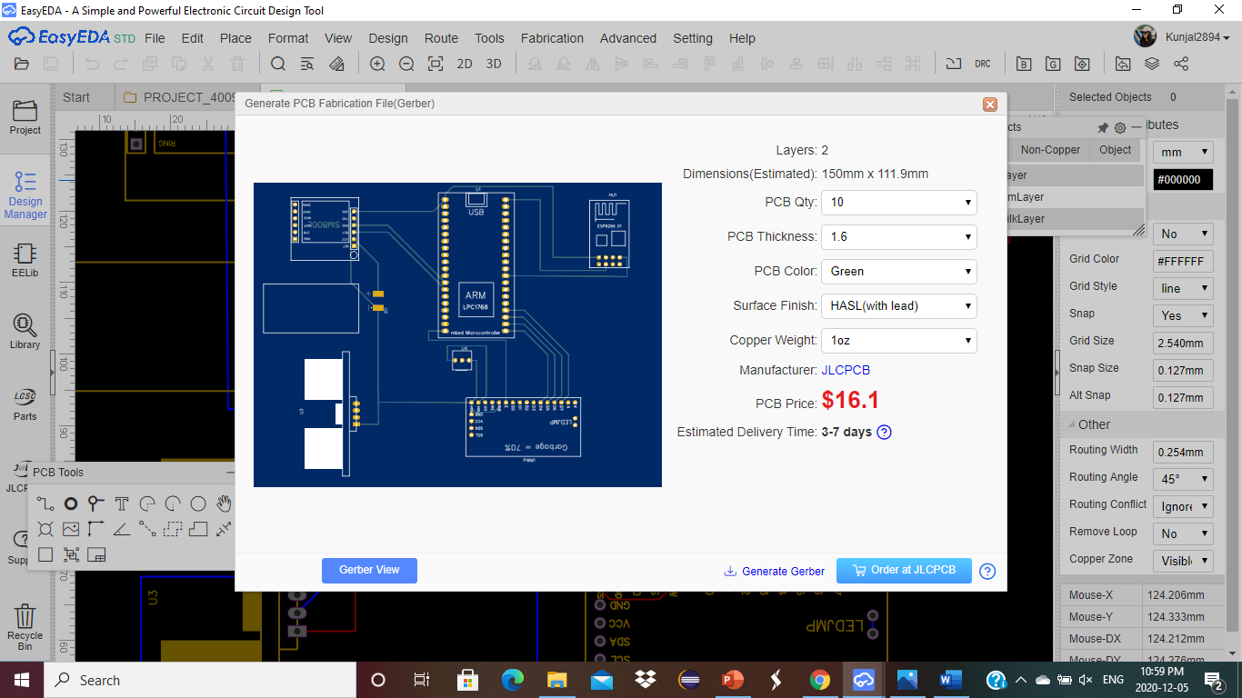
After clicking, will open the Gerber generate dialog:

Slide 29
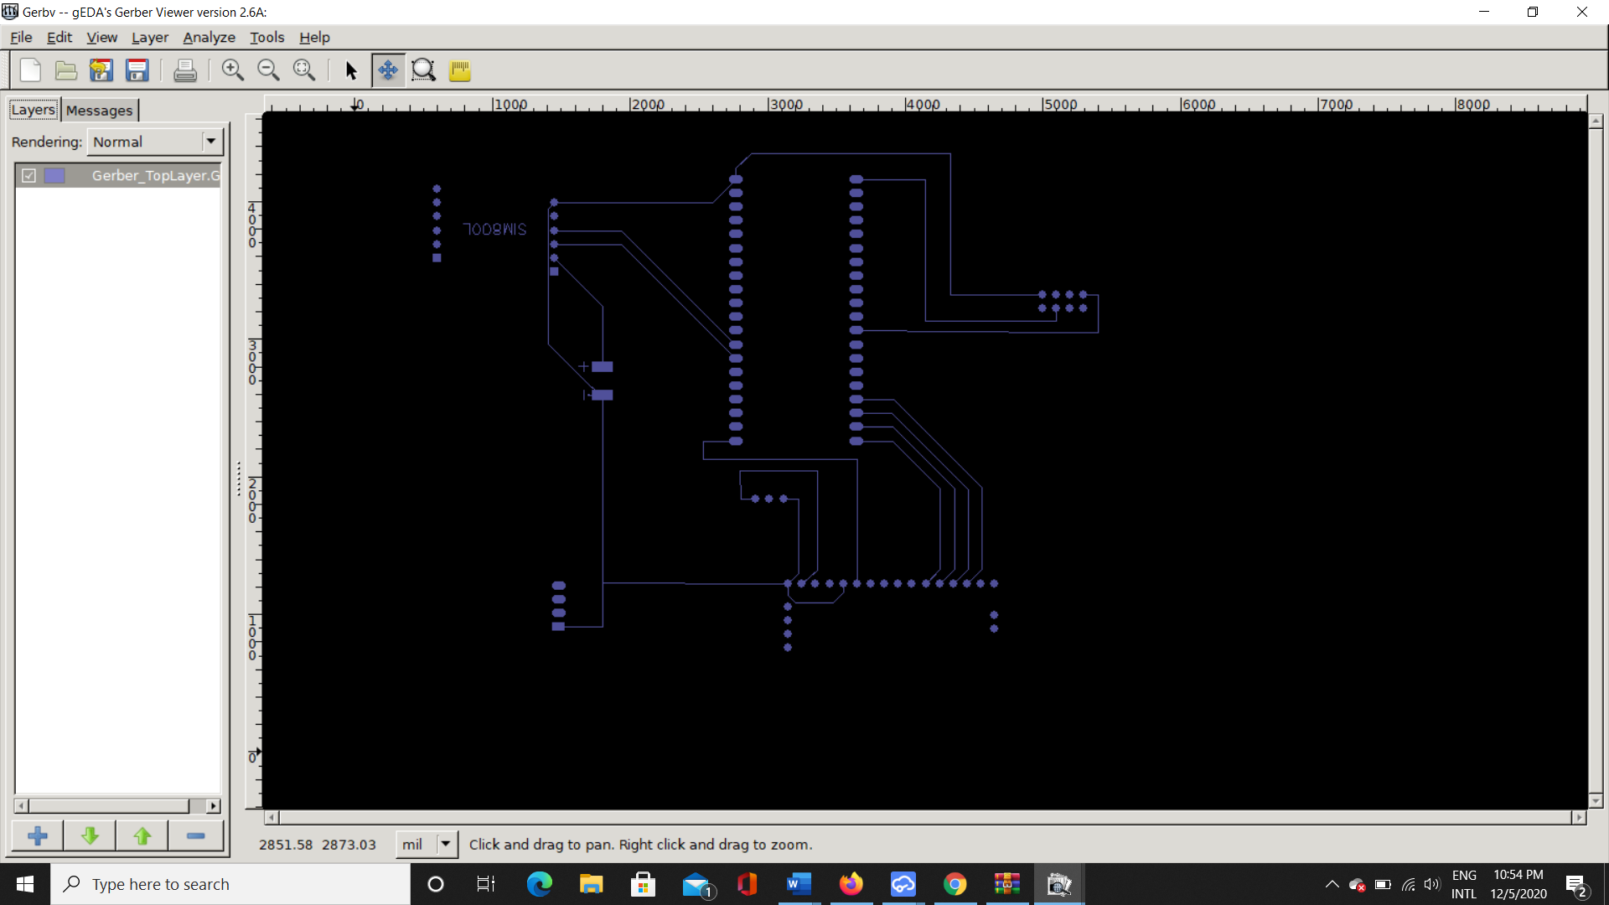
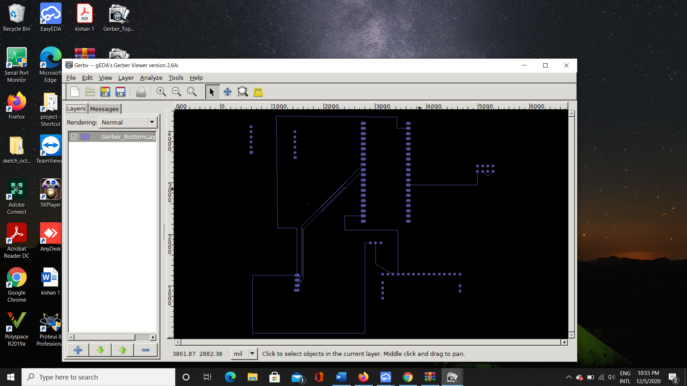
Gerber Views

Slide 30
References
Team, V., Author: VSE | Author:, & You have a need. We can provide a solution. Gerber Files Explained: Understanding Their Role in PCB Manufacturing. Retrieved December 07, 2020, from https://www.vse.com/blog/gerber-files-explained-understanding-their-role-in-pcb-manufacturing/
An Easier and Powerful Online PCB Design Tool. (n.d.). Retrieved December 07, 2020, from https://docs.easyeda.com/en/PCB/Gerber-Generate/index.html
(n.d.). Retrieved December 07, 2020, from https://learn.sparkfun.com/tutorials/pcb-basics/all
Single Sided & Double-Sided PCBs – What's the Difference? - Clarydon Blog. (2017, December 14). Retrieved December 07, 2020, from https://www.clarydon.com/single-sided-double-sided-pcbs-whats-difference

